Slide 1

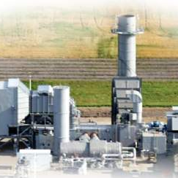



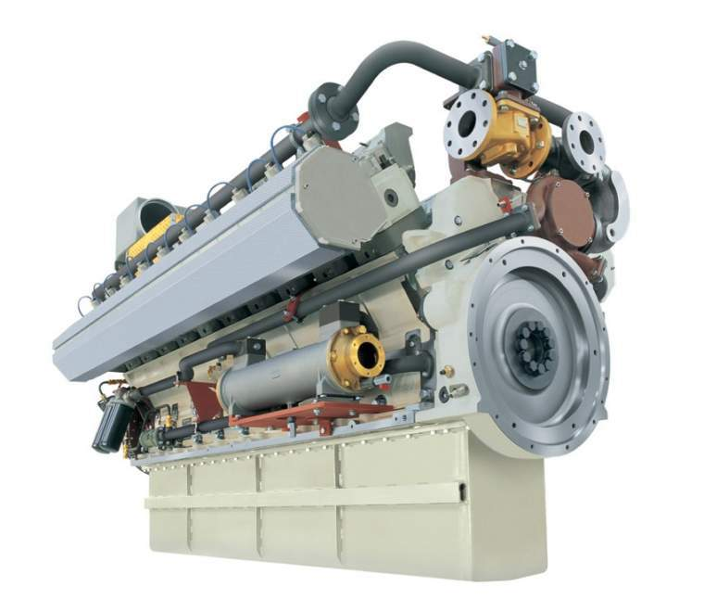
Use of a Turtle Diagram in Monitoring Project Quality
Lorri Williams

Slide 2

Components of Any Process
Process
Inputs
Controllers
Mechanisms
Output

Slide 3
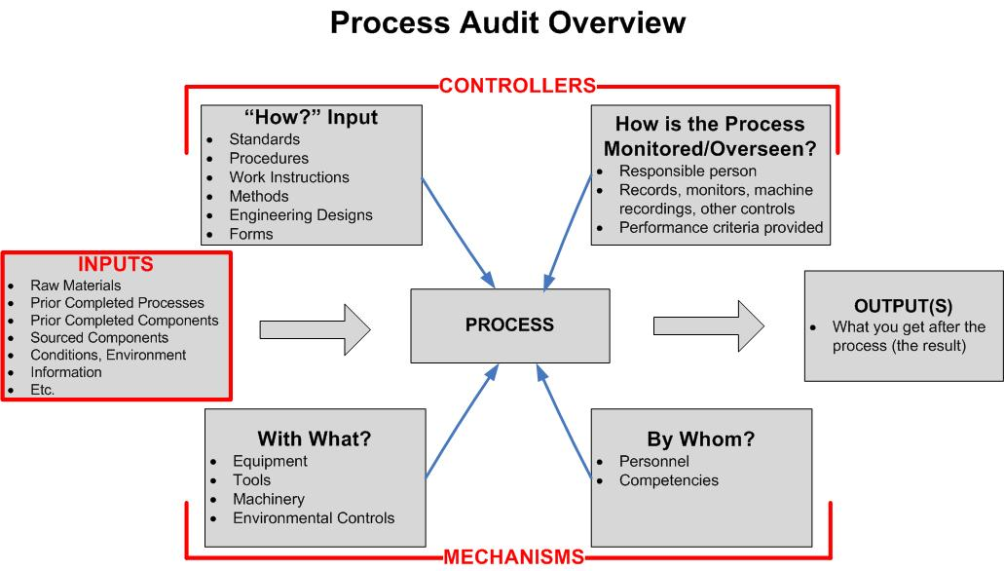
Process Controls Overview
Notes:
Slide Title: Components of Any Process
Time: Brief
Say: Here is a PICMO turtle diagram, which is a tool that can be useful to you in breaking down requirements into their process parts. Go ahead and read through these briefly.
Instructions: Pause briefly to allow participants to review these screens. Then (CLICK) to allow the overlay to fade in.
(CLICK) on slide for next slide.

Slide 4
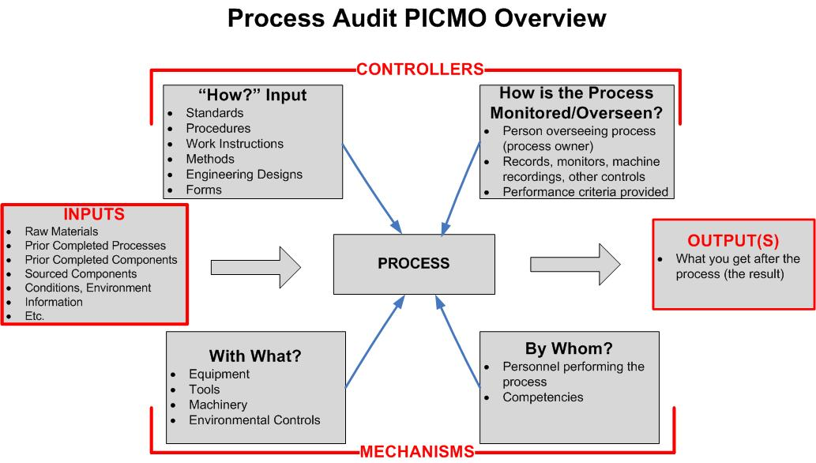
Process
Notes:
Slide Title: Components of Any Process
Time: Brief
Say: You’ll notice the process is at the center of the PICMO diagram. We’ll look at each of the other 4 areas in some more detail on the following slides.
(CLICK) to show next slide.

Slide 5
Inputs
Notes:
Slide Title: Components of Any Process
Time: Brief
Say: An input is any kind of raw or refined material, product, substance, part, environmental factor, or information that is acted upon within the process through mechanisms – as prescribed by controllers – in order to achieve outputs. If it is a transactional process, as in Sourcing, an input may be a document, or an electronic or other approval that has moved from the end of one part of the process to the next.
(CLICK) to show next slide.

Slide 6
Controllers
Notes:
Slide Title: Components of Any Process
Time: Brief
Say: Controllers are the insurance that the process is done correctly. There are two different kinds of controllers. The (CLICK) first kind includes How documents, such as work instructions, methods, design documents, and forms. (CLICK) The second controller is the oversight that is required in order to ensure the work has been accomplished. It is the Quality Assurance piece.
(CLICK) to show next slide.

Slide 7
Mechanisms
Notes:
Slide Title: Components of Any Process
Time: Brief
Say: Mechanisms are the tangible means by which a process is accomplished. There are two categories of mechanisms. (CLICK) The first includes tools, equipment, machinery, gauges, calibrators, etc. (CLICK) The second kind of mechanism is the personnel involved in the process, and includes their level of competency to do the task. For an auditor, this typically concerns evidence in the area of training records for the individuals involved.
(CLICK) to show next slide.

Slide 8
Outputs
Notes:
Slide Title: Components of Any Process
Time: Brief
Say: An output is the end result of the process. It can be any number of things such as a product, a part, a finished edge, a component, a completed form, a signed document…the list of what an output can be is almost endless.
(CLICK) to show next slide.

Slide 9
PMI Body of Knowledge
8.1 Plan Quality
8.2 Perform Quality Assurance
8.3 Perform Quality Control

Slide 10
PMI Body of Knowledge
8.2 Perform Quality Assurance

Slide 11
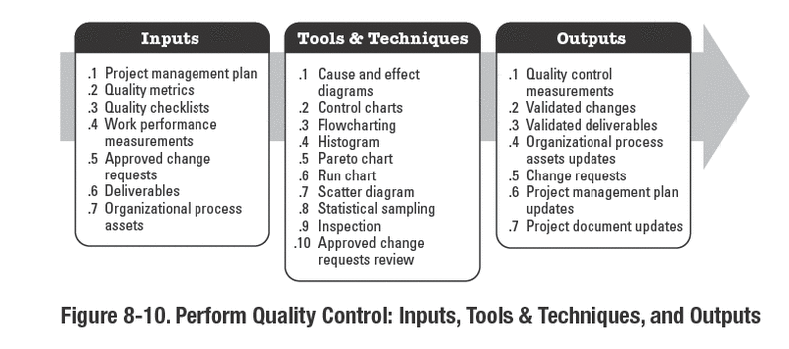
PMI Body of Knowledge
8.3 Perform Quality Control

Slide 12
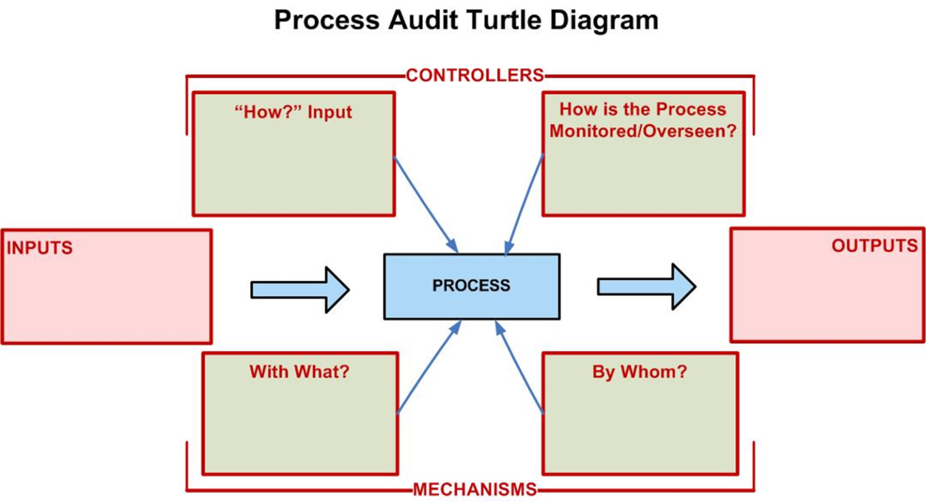
My Process: PICMO Diagram
Meeting templates
Script
Work Instructions
Aligned Audit Manager
Lead Auditor Checklist
Host Checklist
Site info
Pre-audit meeting
Performance metrics
Audit Report
Audit Findings
Audit Recommendations Auditor Evaluations
Gensuite tools (PAT, CC, ATS)
Audit Log
Workflows (on-line)
Qualified Auditors
Lead Auditor
Notes:
Chat window
Activity 1-2: Your Process: PICMO Diagram
Time: 2 minutes
Say: For this set of activities, we’re looking at the process you broke down in your PreWork. Let’s first look at the inputs you identified, whatever they might be.
Say: In your chat window, type in what you believe the input to be for Everyone to see. Remember, this is a process that you identified in your PreWork that you identified.
Instructions: After about 30 seconds, review everyone’s input and comment on what you see. Then:
(CLICK) to show the next slide and the correct answer.

Slide 13
Your Process: PICMO Diagram
Notes:
Chat window
Activity 1-2: Your Process: PICMO Diagram
Time: 2 minutes
Say: For this set of activities, we’re looking at the process you broke down in your PreWork. Let’s first look at the inputs you identified, whatever they might be.
Say: In your chat window, type in what you believe the input to be for Everyone to see. Remember, this is a process that you identified in your PreWork that you identified.
Instructions: After about 30 seconds, review everyone’s input and comment on what you see. Then:
(CLICK) to show the next slide and the correct answer.

Slide 14
Questions?

